Slide 1
Intel 8088/8086 Processor
Dr.N.Arulanand, Professor,
PSG College of Technology

Slide 2
Inside The 8088/8086
Concepts important to the internal operation of 8088/8086
Pipelining
Registers

Slide 3
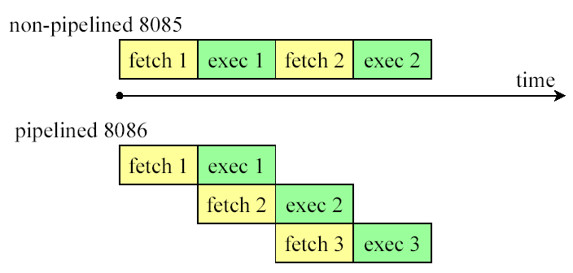
Inside The 8088/8086…pipelining
Pipelining
  Two ways to make CPU process information faster:
    Increase the working frequency – technology dependent
    Change the internal architecture of the CPU
  Pipelining is to allow CPU to fetch and execute at the same time

Slide 4
Inside The 8088/8086…pipelining
Intel implemented the concept of pipelining by splitting the internal structure of the 8088/8086 into two sections that works simultaneously:
Execution Unit (EU) – executes instructions previously fetched
Bus Interface Unit (BIU) – accesses memory and peripherals

Slide 5
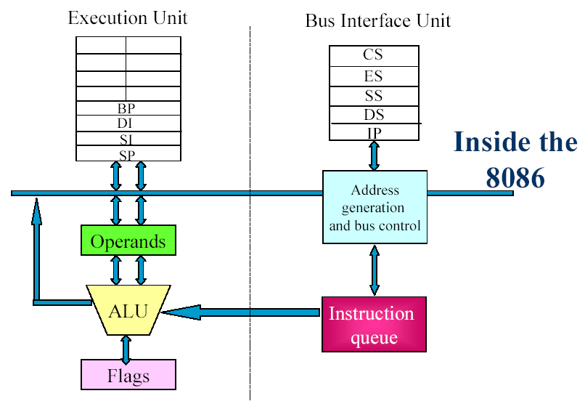
Inside The 8088/8086
AH AL
BH BL
CH CL
DH DL

Slide 6
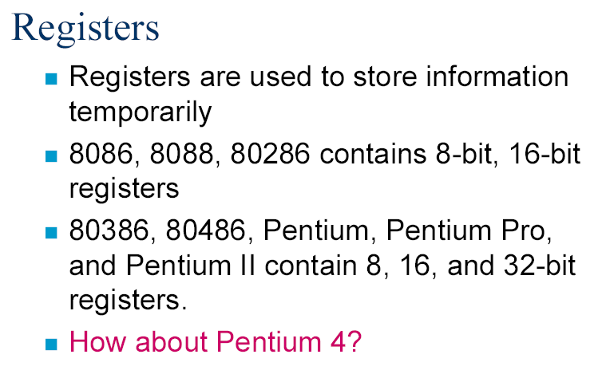

Slide 7
Overview
Registers
  General purpose registers (8)
    Operands for logical and arithmetic operations
    Operands for address calculations
    Memory pointers
  Segment registers (6)
  EFLAGS register
  The instruction pointer register
The stack
Notes:
Page <number>
The definitions of some of these topics rely on an understanding of other topics. An attempt has been made to introduce topics in the best order possible.

Slide 8
Inside The 8088/8086…registers
Registers
  To store information temporarily
AX
16-bit register
AH
8-bit reg.
AL
8-bit reg.
Category Bits Register Names
General 16 AX, BX, CX, DX
8 AH, AL, BH, BL, CH, CL, DH, DL
Pointer 16 SP (stack pointer), BP (base pointer)
Index 16 SI (source index), DI (destination index)
Segment 16 CS (code segment), DS (data segment)
SS (stack segment), ES (extra segment)
Instruction 16 IP (instruction pointer)
Flag 16 FR (flag register)

Slide 9
Anatomy of a Register
Extended Register
Word Register
Bits 16-31
Bits 8-15
Bits 0-7
High Byte
Low Byte
Register
Register
Notes:
Page <number>
In today’s 32-bit architecture, each register has 32 bits that can be used. However, some registers can be accessed as a single byte, and all registers can be accessed as a 16-bit value, or a 32-bit value. This is further explained on the next slide.

Slide 10
General Registers
32 bit Registers |  | 16 bit Registers |  | 8 bit Registers
EAX | EBP | AX | BP | AH | AL
EBX | ESI | BX | SI | BH | BL
ECX | EDI | CX | DI | CH | CL
EDX | ESP | DX | SP | DH | DL
Bits 16-31
Bits 8-15
Bits 0-7
Notes:
Page <number>
The 32-bit general-purpose registers EAX, EBX, ECX, EDX, ESI, EDI, EBP, and ESP are provided for holding the following items: operands for logical and arithmetic operations, operands for address calculations, and memory pointers.
Registers can be broken down into 16 and 8 bit registers.
We will use the notation “(E)AX” to refer to any of AL, AH, AX, or EAX.
Each of the lower two bytes of the EAX, EBX, ECX, and EDX registers can be referenced by the names AH, BH, CH, and DH (high bytes) and AL, BL, CL, and DL (low bytes).
The lower two bytes of the other registers – EBP, ESI, EDI, and ESP – can not be referenced.
Many instructions assign specific registers to hold operands. For example, string instructions use the contents of the ECX, ESI, and EDI registers as operands (details will be given later).

Slide 11
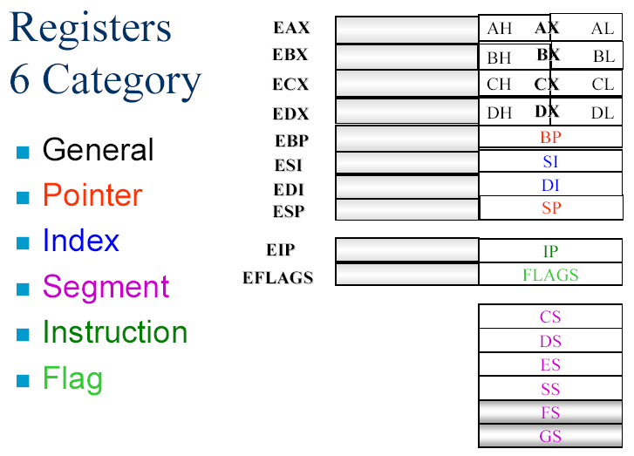

Slide 12
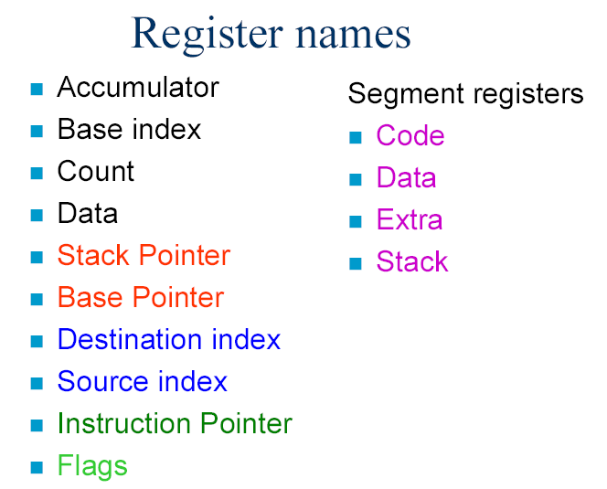

Slide 13
General Registers I
EAX – ‘Accumulator’
  accumulator for operands and results data
  usually used to store the return value of a procedure
EBX – ‘Base Register’
  pointer to data in the DS segment
ECX – ‘Counter’
  counter for string and loop operations
EDX – ‘Data Register’
  I/O pointer
Notes:
Page <number>
By convention, the EAX, EBX, ECX, and EDX registers are often used for the particular purpose as specified. However, each can be used for other purposes as well.
EAX is usually used to store the return value of a procedure.

Slide 14
General Registers II
ESI – ‘Source Index’
  source pointer for string operations
  typically a pointer to data in the segment pointed to by the DS register
EDI – ‘Destination Index’
  destination pointer for string operations
  typically a pointer to data/destination in the segment pointed to by the ES register
Notes:
Page <number>
ESI is typically a pointer to data in the segment pointed to by the DS register. (Segments will be defined shortly.)
EDI is typically a pointer to data/destination in the segment pointed to by the ES register.

Slide 15
General Registers III
EBP – ‘Base Pointer’
  pointer to data on the stack
  points to the current stack frame of a procedure
ESP – ‘Stack Pointer’
  pointer to the top address of the stack
  holds the stack pointer and as a general rule should not be used for any other purpose
Notes:
Page <number>
The base pointer (EBP) usually points to the current stack frame of a procedure. Procedure parameters are usually at positive offsets from EBP (e.g., EBP+8). Local variables are usually at negative offsets (e.g., EBP-16). Sometimes, optimizing compilers won't use a stack frame, and in this case, EBP is used as a multipurpose register.
The stack pointer (ESP) is implicitly changed by PUSH, POP, CALL, and RET instructions (to be defined later).
Both EBP and ESP point to data in the stack segment.
Although these and all general registers are available for general storage of operands, results, and pointers, caution should be used when referencing the ESP register. The ESP register holds the stack pointer and as a general rule should not be used for any other purpose.

Slide 16
Segment Registers
CS – ‘Code Segment’
  contains the segment selector for the code segment where the instructions being executed are stored
DS(ES,FS,GS) – ‘Data Segment’
  contains the segment selectors for the data segment where data is stored
SS – ‘Stack Segment’
  contains the segment selector for the stack segment, where the procedure stack is stored
Notes:
Page <number>
The six segment registers hold 16-bit segment selectors. A segment selector is a special pointer that identifies a segment in memory. To access a particular segment in memory, the segment selector for that segment must be present in the appropriate segment register.
Each of the segment registers is associated with one of three types of storage: code, data, or stack.
The DS, ES, FS, and GS registers point to four data segments. The availability of four data segments permits efficient and secure access to different types of data structures.
The CS register cannot be loaded explicitly by an application program. It must be loaded implicitly by instructions or internal processor operations that change program control (e.g., procedure calls).
All stack operations use the SS register to find the stack segment. Unlike the CS register, the SS register can be loaded explicitly, which permits application programs to set up multiple stacks and switch among them.
Sometimes SS has the same values as DS.
To refer to a register and the particular segment to which it is pointing, we use notation like “ES:EDI”, “ES:DI”, and “DS:ESI”.

Slide 17
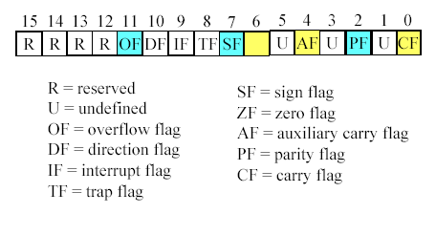
Flag Register
Flag Register (status register)
  16-bit register
  Conditional flags: CF, PF, AF, ZF, SF, OF
  Control flags: TF, IF, DF
ZF

Slide 18
The FLAGS Register I
Carry Flag – CF (bit 0)
  Set if an arithmetic operation generates a carry or a borrow out of the most-significant bit of the result; cleared otherwise.
Parity Flag – PF (bit 2)
  Set if the least-significant byte of the result contains an even number of 1 bits; cleared otherwise.
Adjust Flag – AF (bit 4)
  Set if an arithmetic operation generates a carry or a borrow out of bit 3 of the result; cleared otherwise.
Notes:
Page <number>
The status flags (bits 0, 2, 4, 6, 7, and 11) of the EFLAGS register indicate the results of arithmetic instructions, such as the ADD, SUB, MUL, and DIV instructions. The EFLAGS register is modified automatically by the CPU after mathematical operations. Generally you cannot access these registers directly.
We will see that some instructions such as conditional jumps rely on the contents of the EFLAGS register to make decisions.
The carry flag indicates an overflow condition for unsigned-integer arithmetic. It is also used in multiple-precision arithmetic.
The adjust flag is used in binary-coded decimal (BCD) arithmetic.
Of the six status flags we define on the slides, only the CF flag can be modified directly, using the STC, CLC, and CMC instructions. The bit instructions (BT, BTS, BTR, and BTC) copy a specified bit into the CF flag. See the Intel manual for details.

Slide 19
The ELAGS Register II
Zero Flag – ZF (bit 6)
  Set if the result is zero; cleared otherwise
Sign Flag – SF (bit 7)
  Set equal to the most-significant bit of the result, which is the sign bit of a signed integer
Overflow Flag – OF (bit 11)
  Set if the integer result is too large a positive number or too small a negative number (excluding the sign-bit) to fit in the destination operand; cleared otherwise
Notes:
Page <number>
With respect to the SF flag, 0 indicates a positive value and 1 indicates a negative value.
The OF flag indicates an overflow condition for signed-integer (two’s complement) arithmetic.
There are other flags contained in the EFLAGS register are:
Bit 9 – Interrupt enable flag
Bit 10 – Direction flag. This flag determines whether the EDI/ESI registers will be incremented or decremented during string operations.
Bit 11 – Overflow flag
Bits 12-13 – IOPL I/O Priviledge level
Bit 14 – NT Nested task flag
Bit 16 – RF Resume flag
Bit 17 – VM Virtual 8086 mode flag
Bit 18 – AC Alignment check flag (486+)
Bit 19 – VIF Virtual interrupt flag
Bit 20 – VIP Virtual interrupt pending flag
Bit 21 – ID flag
Bits in the EFLAGS register that we have not listed are reserved by Intel.

Slide 20
Flag Register and ADD instruction
Flag Register that may be affected
  Conditional flags: CF, PF, AF, ZF, SF, OF

Slide 21
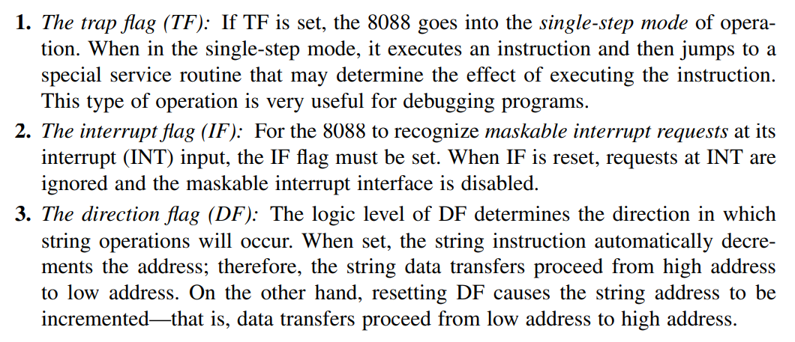
Status Register

Slide 22
Instruction Pointer
EIP
  ‘Instruction Pointer’
  Contains the offset within the code segment of the next instruction to be executed
  Cannot be accessed directly by software
Notes:
Page <number>
The processor fetches instructions from the code segment, using a logical address that consists of the segment selector in the CS register and the contents of the EIP register. The EIP register contains the offset within the code segment of the next instruction to be executed.
The EIP register cannot be accessed directly by software; it is controlled implicitly by control transfer instructions (e.g., procedure calls or jump statements), interrupts, and exceptions.
The only way to read the EIP register is to execute a CALL instruction and then read the value of the return instruction pointer from the procedure stack.
The EIP register can be loaded indirectly by modifying the value of a return instruction pointer on the procedure stack and executing a return instruction.

Slide 23
Endian conversion
Little endian conversion:
In the case of 16-bit data, the low byte goes to the low memory location and the high byte goes to the high memory address. (Intel, Digital VAX)
Big endian conversion:
The high byte goes to low address. (Motorola)
Example:
Suppose DS:6826 = 48, DS:6827 = 22,
Show the contents of register BX in the instruction MOV BX,[6826]
Little endian conversion: BL = 48H, and BH = 22H

Slide 24
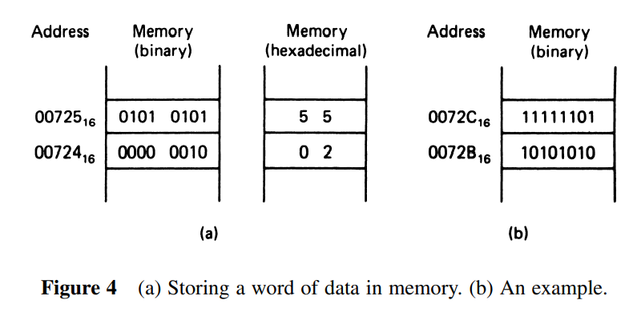
Aligned and Misaligned word
To permit efficient use of memory, words of data can be stored at what are called even- or odd-addressed word boundaries. The least significant bit of the address determines the type of word boundary. If this bit is 0, the word is at an even-address boundary

Slide 25
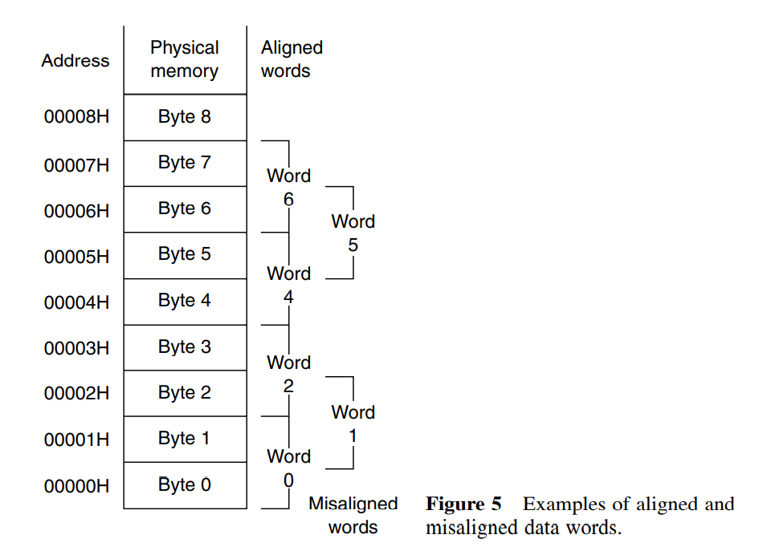
Double Word

Slide 26
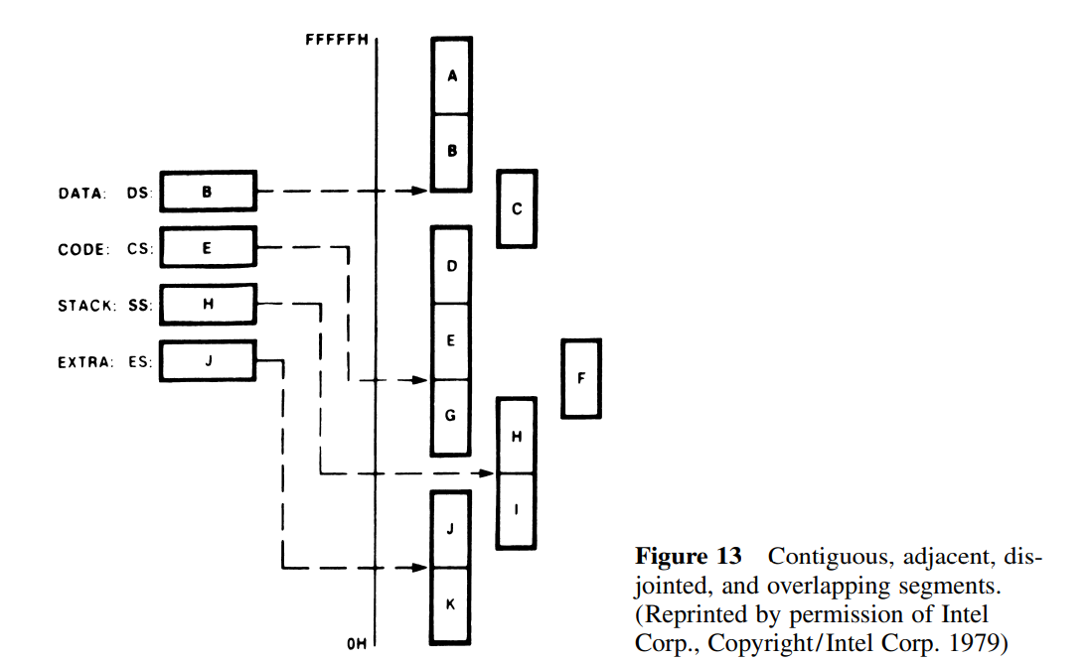
Software Architecture of 8088/8086 Microprocessors

Slide 27
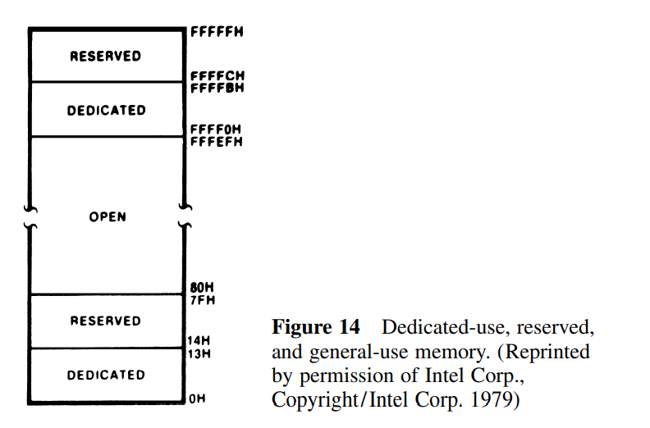
Software Architecture of 8088/8086 Microprocessors
Address 00000h to 00013h are dedicated, and those from address 00014h to 0007Fh are reserved. These 128 bytes of memory are used for storage of pointers to interrupt service routines
Address FFFFCh through FFFFFh. These four memory locations are reserved for use with future products and should not be used
Address FFFF0h through FFFFBh as dedicated for functions such as storage of the hardware reset jump instruction

Slide 28
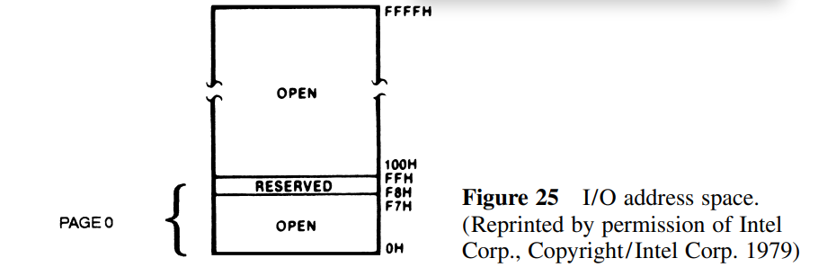
I/O Address Space
The I/O address space is the place where I/O interfaces, such as printer and monitor ports, are implemented
Address range is from 0000h to FFFFh.
This represents just 64Kbyte addresses
Unlike memory, I/O addresses are only 16 bits long
The part of the map from address 000016 through 00FF16 is referred to as page 0

Slide 29
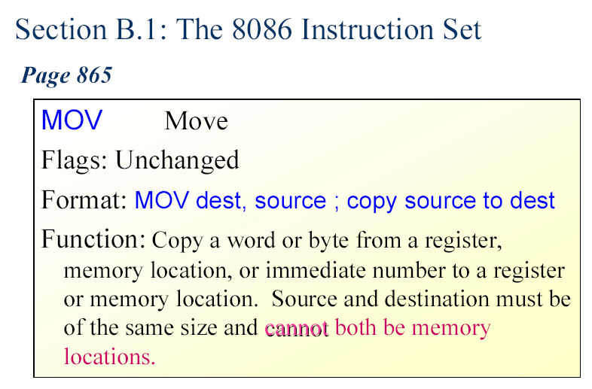

Slide 30
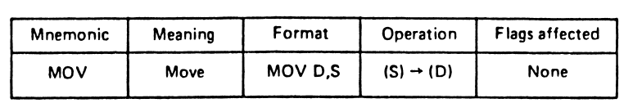
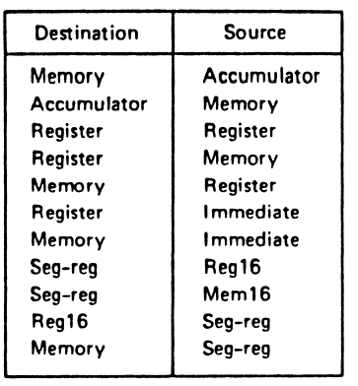
The MOV Instruction

Slide 31
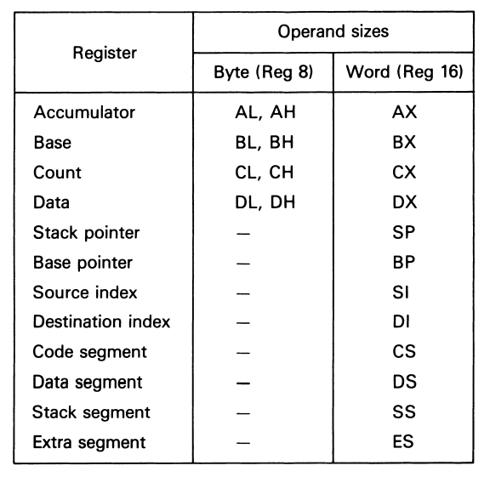
Register addressing registers and operand sizes

Slide 32
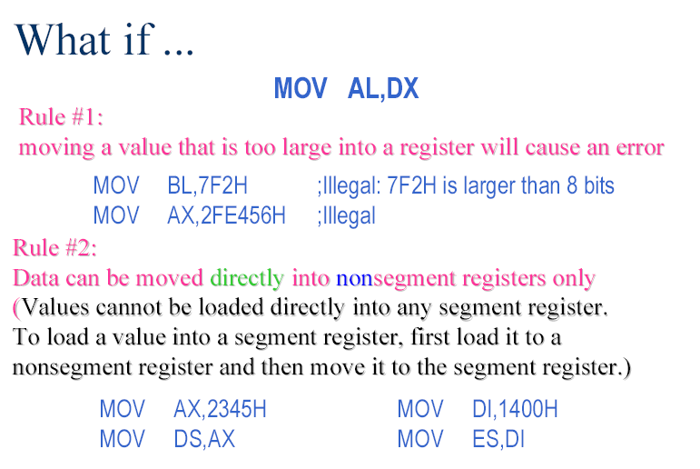
Rule #3:
If a value less than FFH is moved into a 16-bit register, the rest of the
bits are assumed to be all zeros.
MOV BX, 5 BX =0005
BH = 00, BL = 05

Slide 33
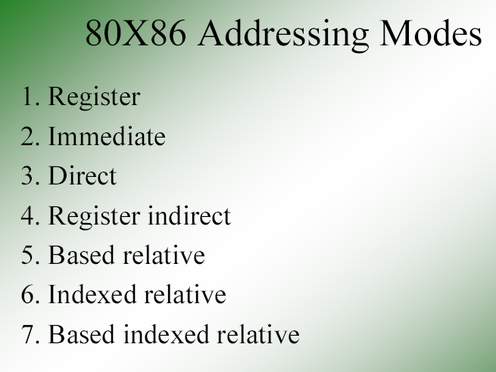
Addressing Modes – Accessing operands (data) in various ways

Slide 34
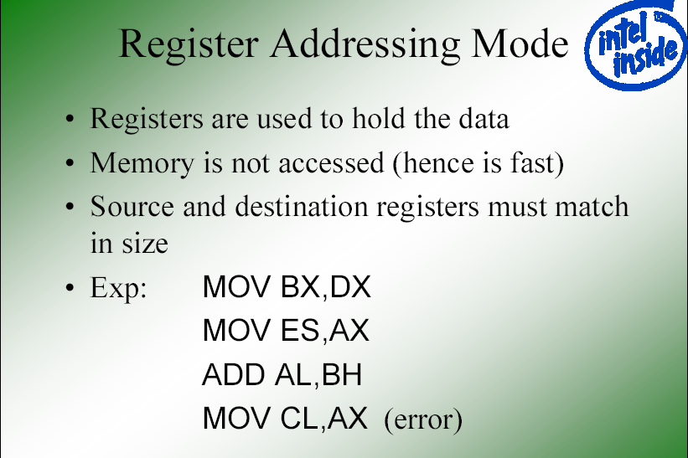

Slide 35
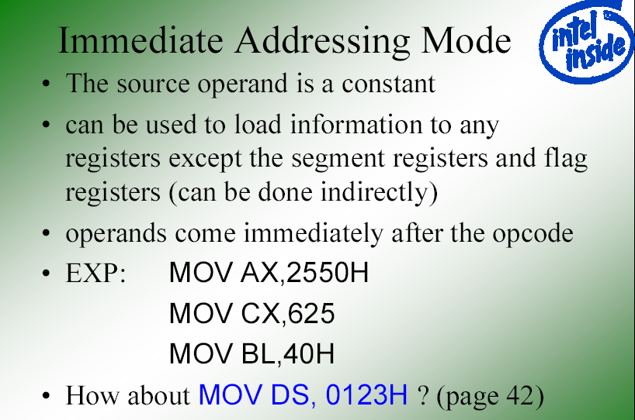

Slide 36
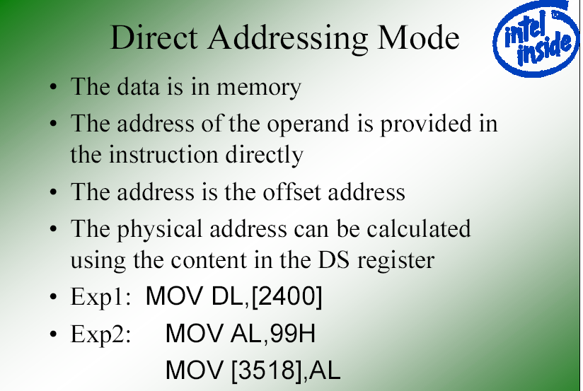
;move contents of DS:2400H into DL

Slide 37
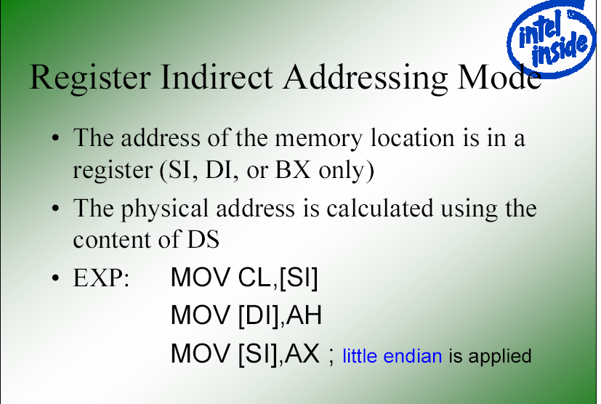
;move contents of DS:SI into CL
;move contents of AH into DS:DI
;moves contents of AX into memory
;locations DS:SI and DS:SI +1

Slide 38
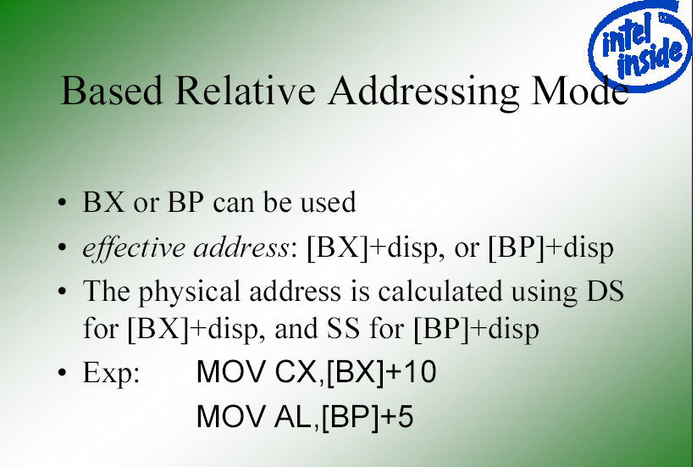
;move DS:BX+10 & DS:BX+10+1
;into CX. PA= DS(sl) +BX+10
;PA = SS (sl) + BP + 5

Slide 39
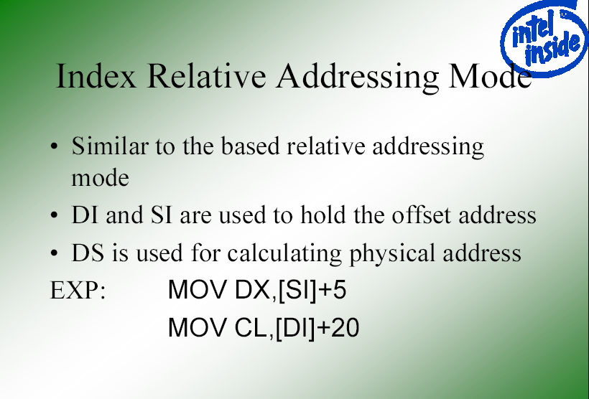
;PA = DS (sl) + SI + 5
;PA = DS (sl) + DI + 20

Slide 40
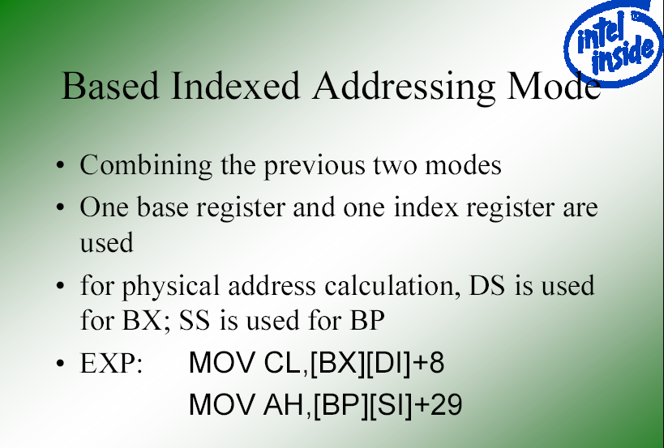
;PA=DS(sl)+BX+DI +8
;PA=SS(sl)+BP+SI +29

Slide 41
Intel Architecture
References
  IA-32 Intel® Architecture Software Developer’s Manual,
    Volume 1: Basic Architecture
    Volume 2: Instruction Set Reference
    www.intel.com/design/pentiumii/manuals/
Notes:
Page <number>
References (some content contained in this presentation is taken directly from these references):
IA-32 Intel® Architecture Software Developer’s Manual, Volume 1: Basic Architecture (www.intel.com/design/pentiumii/manuals/).
IA-32 Intel® Architecture Software Developer’s Manual, Volume 2: Instruction Set Reference (www.intel.com/design/pentiumii/manuals/).

